Slide 1
Elementary and Secondary School Emergency Relief (ESSER) Roundtable Series: ARP ESSER- An Overview and Review of Allowable Uses
New Jersey Department of Education
Division of Educational Services
October 19, 2022
Notes:
Anthony

Slide 2
Agenda
Housekeeping Educational Services
Allowable Uses: Overview Peggy Porsche, Office of Educational Services
Dr. A Charles Wright, Executive Director, Division of Educational Services
Kathleen Ehling, Assistant Commissioner
District Presentation
Barnegat Public Schools
Lyndhurst Public Schools
Voorhees Township Public Schools
Wildwood Public Schools
Notes:
Anthony

Slide 3
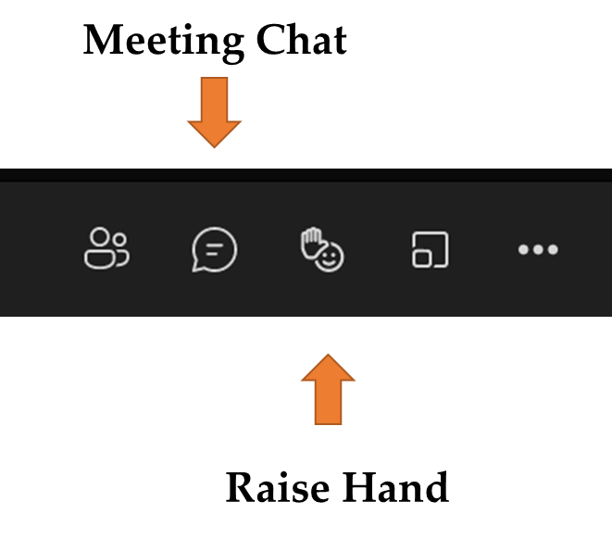
Using Microsoft Teams
Chat
We welcome your participation in discussions by asking questions and adding comments in the chat box.
Raise Hand
Please use the raise hand feature if you want to speak.
Mute/Unmute
Please remain muted whenever you are not speaking.
Notes:
Peggy

Slide 4
Welcome Dr. A. Charles Wright Executive Director/Deputy Assistant Commissioner Division of Educational Services
Notes:
Kathy
The next few slides review the allowable uses of the ESSER funds.
Next slide

Slide 5
ARP ESSER: An Overview and Review of Allowable Uses
Notes:
Kathy
The next few slides review the allowable uses of the ESSER funds.
Next slide

Slide 6
Intent and Purpose of ARP ESSER Funding
To help safely reopen and sustain the safe operation of schools and address the impact of the coronavirus pandemic on students.

Slide 7
Overview of Federal Relief Funds
New Jersey received over $4 billion in Federal emergency funds including:
ESSER I | $310,371,213
ESSER II | $1,230,971,757
ARP ESSER | $2,766,529,533
ARP IDEA | $79,863,122
ARP HCY | $18,118,224
Notes:
Kathy
It is truly staggering to think about the amount of emergency relief funds that have been allocated to education in the last year. Over the last 18 months, more than $4.5 BILLION Federal dollars will have been allocated to NJ school districts. In the words of Notorious B.I.G. This means, Mo Money Mo Problems. Or to paraphrase Peter Parker: With great wealth comes great responsibility
This amount of funding also brings with it a great deal of work. From determining how best to spend the funds, to purchasing items or running programs, to collecting an analyzing data on the effectiveness of those same programs, this has been an extremely busy time in the grant world.
Next slide

Slide 8
Allowable Activities and Use of Funds (1 of 8)
Any activity authorized by the ESEA, including the Native Hawaiian Education Act and the Alaska Native Educational Equity, Support, and Assistance Act (20 U.S.C. 6301 et seq.).
Any activity authorized by the Individuals with Disabilities Education Act (IDEA) (20 U.S.C. 1400 et seq.).
Any activity authorized by the Adult Education and Family Literacy Act (AEFLA) (29 U.S.C. 3271 et seq.).
Any activity authorized by the Carl D. Perkins Career and Technical Education Act of 2006 (Perkins V) (20 U.S.C. 2301 et seq.).
Any activity authorized by subtitle B of title VII of the McKinney-Vento Homeless Assistance Act (McKinney-Vento) (42 U.S.C. 11431 et seq.).

Slide 9
Allowable Activities and Use of Funds (2 of 8)
Coordinating preparedness and response efforts of LEAs with State, local, Tribal, and territorial public health departments, and other relevant agencies, to improve coordinated responses among such entities to prevent, prepare for, and respond to COVID-19.
Providing principals and other school leaders with the resources necessary to address the needs of their individual schools.
Activities to address the unique needs of low-income children or students, students with disabilities, 4 English learners, racial and ethnic minorities, students experiencing homelessness, and children and youth in foster care, including how outreach and service delivery will meet the needs of each population.

Slide 10
Allowable Activities and Use of Funds (3 of 8)
Developing and implementing procedures and systems to improve the preparedness and response efforts of LEAs.
Training and professional development for staff of the LEA on sanitation and minimizing the spread of infectious diseases.
Purchasing supplies to sanitize and clean the facilities of the LEA, including buildings operated by such LEA.

Slide 11
Allowable Activities and Use of Funds (4 of 8)
Planning for, coordinating, and implementing activities during long-term closures, including providing meals to eligible students, providing technology for online learning to all students, providing guidance for carrying out requirements under the IDEA and ensuring other education services can continue to be provided consistent with all Federal, State, and local requirements.
Purchasing educational technology (including hardware, software, and connectivity) for students who are served by the LEA that aids in regular and substantive educational interaction between students and their classroom instructors, including low-income students and students with disabilities, which may include assistive technology or adaptive equipment.

Slide 12
Allowable Activities and Use of Funds (5 of 8)
Providing mental health services and supports, including through the implementation of evidence-based full-service community schools.
Planning and implementing activities related to summer learning and enrichment and supplemental after-school programs, including providing classroom instruction or online learning during the summer months and addressing the needs of low-income students, students with disabilities, English learners, migrant students, students experiencing homelessness, and children and youth in foster care.

Slide 13
Allowable Activities and Use of Funds (6 of 8)
Addressing the academic impact of lost instructional time among LEA’s students, including low-income students, students with disabilities, English learners, racial and ethnic minorities, students experiencing homelessness, and children and youth in foster care.
School facility repairs and improvements to enable operation of schools to reduce risk of virus transmission and exposure to environmental health hazards, and to support student health needs.

Slide 14
Allowable Activities and Use of Funds (7 of 8)
Developing strategies and implementing public health protocols including, to the greatest extent practicable, policies in line with guidance from the CDC for the reopening and operation of school facilities to effectively maintain the health and safety of students, educators, and other staff.
Other activities that are necessary to maintain the operation and continuity of services in the LEA and continuing to employ existing staff of the LEA.

Slide 15
Allowable Activities and Use of Funds (8 of 8)
Inspection, testing, maintenance, repair, replacement, and upgrade projects to improve the indoor air quality in school facilities, including mechanical and non-mechanical heating, ventilation, and air conditioning systems, filtering, purification and other air cleaning, fans, control systems, and window and door repair and replacement.

Slide 16
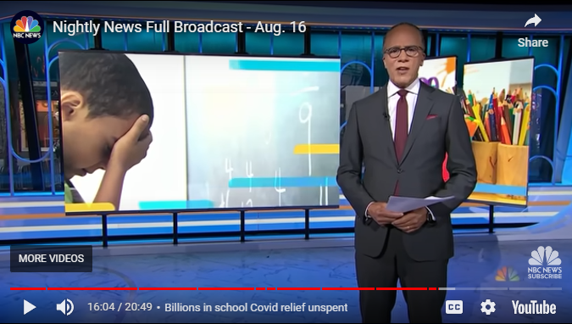
ESSER Round Table
NBC Nightly News with Lester Holt
August 16, 2022
Kids Under Pressure
https://www.youtube.com/watch?v=n1MLHKQiHcE&t=964s

Slide 17
District Presentations
Notes:
Anthony

Slide 18
Barnegat Township Public School District Steven Brenan Business Manager
Notes:
Anthony

Slide 19
ESSER FUND ALLOCATIONS
ESSER I (Spring 2020) $ 581,904
Pandemic impact unknow
Primary focus
Out of District Tuition
Creates flexibility in General Budget
ESSER II (Winter 2021) $2,257,410
Pandemic remained relatively uncertain
Primary focus
Sanitation
Distance Learning
ESSER III (Summer 2021) $5,073,383
Pandemic end in sight
Allowable expenses more restrictive

Slide 20
ESSER III FUND ALLOCATION
Base Allocation $5,073,383
20% Set Aside = $1,014,677
Equipment/Supply = $4,058,706
20% Set Aide
Primary focus
Student support programs
Summer academies
Equipment/Supplies
Primary focus
HVAC Upgrades
Upgrade other infrastructure

Slide 21
ESSER III FUND PREPARATION
FACILITY ASSESSMENT
TECHNOLOGY PLAN
ENERGY SAVINGS IMPROVEMENT PLAN

Slide 22
ESSER III CONCLUSION
Preparation
We were prepared for the unexpected
Implemented plans quicker than expected
Flexibility
Cost/Benefit
Look at whole picture
Collaborate
Working together during unprecedented times brings unique ideas and strategies.
FEMA Difficulties
NJOEM Public Assistance Unit
School District Colleagues

Slide 23
ESSER III IMPLEMENTATION STRATEGIES
Facility Assessment
District committed to addressing infrastructure Pre-Pandemic
Prepared for significant unexpected funding
Technology Plan
District committed to addressing instructional tech Pre-Pandemic
Prepared for significant unexpected funding
Energy Savings Improvement Plan
Initiated implementation pre pandemic
Partnered funds with ESSER III to maximize bid efficiency

Slide 24
Brick Township Public School District Dr. Thomas G. Farrell Superintendent Superintendent Mr. James Edward, Business Administrator
Notes:
Anthony

Slide 25
Brick Township Public School District
Notes:
Anthony

Slide 26
FISCAL PHILOSOPHY
Applied one-time revenue sources to one-time expenditures
(including capital improvements)
Our approach was these one-time funding sources were not for continuous use and could not be maintained
Through Facilities Committee of the Board of Education worked with District Architect’s of Record to select schools in greatest need for HVAC improvements

Slide 27
ESSER FUNDS
TOTAL UTILIZED FOR HVAC = $9,704,002
Facilities Improvements & Equipment
Improve Air Quality in Schools
In response to COVID 19, District decided to upgrade/replace/install unit ventilators and air conditioning in schools to improve air quality and ventilation.
Previous District ventilation systems in school buildings did not meet industry standards and guidelines established by CDC, NJDOH, and ASHRAE to reduce transmission and exposure to health hazards.

Slide 28
Questions and Contact
Contact Information
Dr. Thomas G. Farrell
Superintendent – Brick Township Public Schools
tfarrell@brickschools.org
732-785-3000 x 1019
James Edwards
Business Administrator- Brick Township Public Schools
732-785-3000 x 1016
jedwards@brickschools.org

Slide 29
Lyndhurst Public School District Joseph DeCorso Superintendent
Notes:
Anthony

Slide 30
High School – HVAC Project
2nd Floor of the High School had no AC.
Intolerable for both staff and students.
The environment was not conducive to learning, especially while wearing a mask. In order to prepare for the potential of masking in the future, AC was needed.
Prevent faculty and parent letters that the high school rooms are too hot for masks. (We received doctor’s notes.)
The district was unable to allocate district funds for the project. The infusion of the ESSER funds really allowed Lyndhurst to explore the possibility of cooling the second floor.

Slide 31
Planning and Budgeting
Initial contractor was brought in for an estimate. We felt the quote was too high; in addition the project would have to go out for bid. (Time and cost restrictions. Estimate was roughly $248,000.)
Began to research cooperative agreements.
Completed the necessary paperwork and board resolutions to join several cooperative agreements and consortiums.
We are now members of ESCNJ, HCESC, and 8UCCP.
Had vendors from the cooperatives come to give estimates.
Vendor from ESCNJ was secured for HVAC.
Local vendor was selected for window panels. (Under bid threshold.)
PO’s sent so the AC’s/Window Panels could be ordered and the electrical work could be started. ($169,925 in total)
$78,075 was saved from initial estimate.

Slide 32
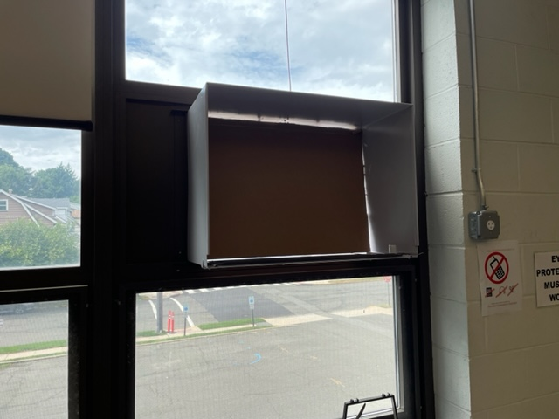
Final Product

Slide 33
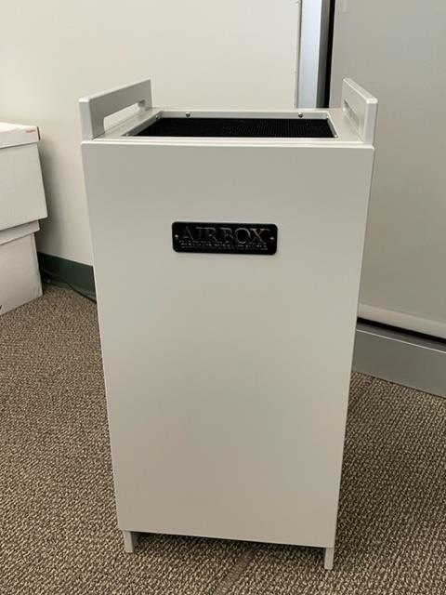
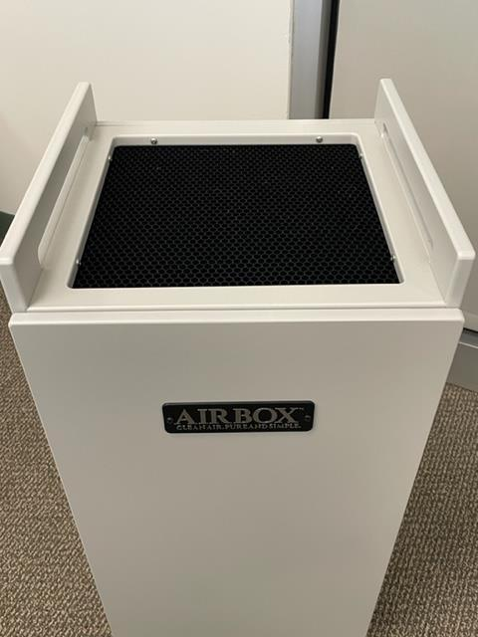
Ventilation Project
Air Box Purifiers
Purchased for classrooms and offices
Larger units bought for the gyms and nurse offices
Filter replacement in local budget moving forward

Slide 34
Questions and Contact (LPS)
Contact Information
Joseph DeCorso
Superintendent – Lyndhurst Public Schools
josephdecorso@lyndhurst.k12.nj.us
201-438-5683 ext. 4802

Slide 35
Voorhees Township Public School District Dr. Neely Hackett Superintendent Helen Haley Business Adminissstrator
Notes:
Anthony

Slide 36
Overview
In February 2021, the ESSER II grant allocation guidelines included allowable uses for “testing, repairing and upgrading projects to improve air quality in school buildings.” Rather than apply this grant to offset amounts already spent in this area, the Voorhees Township Public School District decided to use a portion of the grant to install additional measures to continue to improve air quality. One such project was to install needle-point bi-polar ionization technology in every unit ventilator throughout the District with our employees doing the installation. In addition, we established a goal of testing every building completely each year in regard to indoor air quality. The deadline for submitting this grant was May 14, 2021.
In May 2021, the ARP ESSER III grant allocation was provided. The purpose of this grant was to help districts “safely reopen, sustain the safe operation of schools and address the impacts of the COVID-19 pandemic on the nation’s students.” Allowable uses were similar to the ESSER II grant, so the Voorhees Township Public School District allocated funds to continue to improve air quality in our schools through the replacement of windows and HVAC units as well as purchasing HVAC filters. The deadline for submitting this grant was November 24, 2021

Slide 37
ESSER Grant Allocations and HVAC
Grant | Total Allocation* | HVAC Appropriation | Percentage of Total Set Aside for HVAC
CRRSA - ESSER II | $739,653 | $183,909 | 25%
ARP - ESSER III | $1,662,323 | $443,160 | 27%
Total | $2,401,976 | $627,069 | 26%
*General allocation, does not include subgrants specified for accelerated learning, mental health, etc.

Slide 38
CRRSA - ESSER II
Needle-Point Bi-Polar Ionization Technology for HVAC Units
Purchased 243 Nu-Calgon iWave devices (with needle-point bi-polar ionization technology) in March 2021 using $67,909 in grant funds. Product details link: 4-100-iwaveapplctn.pdf
Most of the installation was done in house by our facilities staff
We purchased 189 additional ionizers using district funds; the use of the grant funds allowed us to purchase enough ionizers to be installed in all units district wide.
Rooms with no windows were prioritized during the installation.
Positive Outcomes
Installation of ionizers allowed us to be proactive in taking measures to mitigate the spread of COVID and other airborne illnesses and to improve overall indoor air quality.
Needle-Point Ionizers kill pathogens (bacteria & viruses), reduce airborne particles (including mold), and control allergens and odors.
They are energy efficient and cost efficient as they are designed to last the usable life of the HVAC unit.
Ionizers are considered more effective than UV lighting as they address pathogens through the coil, ducts and living space rather than just particles that pass through the UV lighting.

Slide 39
CRRSA - ESSER II cont.
Indoor Air Quality Tests
Allocated $116,000 to have indoor air quality (IAQ) tests conducted 4 times per year in order to inspect every classroom across the district.
Previously, IAQ was tested once a year in a sampling of classrooms in each school prior to the start of school.
Quarterly testing began in July 2021.
All classrooms were tested in August 2022.
Positive Outcomes
Reduced requests for indoor air quality tests.
Staff and community feel more comfortable knowing that tests are being conducted and issues addressed proactively rather than reactively.

Slide 40
ARP - ESSER III
HVAC Unit Replacements
Ordered 20 classroom unit ventilators in April 2022 with installation planned for summer 2022.
Purchase was split funded between the grant ($123,160) and the general fund. Use of grant funds allowed us to charge less than half of the project to the district budget.
Supply chain issues have delayed installation.
Window Replacements
Scheduled window replacements for 23 classroom across 3 schools (16 rooms have been completed to date).
Rooms had old windows that either did not open or no longer opened properly - this did not allow for fresh air into the rooms.
Budgeted allocation ($310,000) will allow for 7 more rooms to be updated.

Slide 41
ARP - ESSER III cont.
HVAC Filters
Budgeted allocation of $10,000 to purchase filters for our HVAC systems.
Positive Outcomes - Unit Replacements, Window Replacement, Filter Purchases
Taking a proactive approach to avoid breakdowns that would result in potential downtime and issues as equipment reaches the end of its usable life.
Expected improvements to indoor air quality.
Energy efficiency with new units.
Increased fresh air flow with windows that can be opened.

Slide 42
Questions and Contact (VTPS)
Voorhees Township Public School
haley@voorhees.k12.nj.us
Contact Information Helen Haley
Business Administrator

Slide 43
Wildwood Public School District J. Kenyon Kummings Chief School Administrator Jason Fuscellaro Business Administrator
Notes:
Anthony

Slide 44
WILDWOOD HIGH SCHOOL
HVAC RENOVATION PROJECT

Slide 45
FUNDING
CRSSA – ERRER II | $1,862,706
ARP – ESSER | $3,349,050
TOTAL ESSER FUNDS | $5,211,756
Capital Reserve 2021-2022 | $1,714,150
TOTAL FUNDS AVAILABLE | $6,925,906
Budgeted Fund 12 (2021-2022) | $700,000 | Architect/Engineer
TOTAL FUNDS | $7,625,906

Slide 46
NEEDS ASSESSMENT
Began the interactive process with school board and architects.
Examined facilities needs at all campuses to determine best use of funds.
The focus was on the aging HVAC systems at the district’s elementary and middle/high school buildings.

Slide 47
DECISIONS
Based on the outcome of the needs assessment, it was determined that the most immediate need was at the middle/high school.
Aging steam system and infrastructure.
End of life mechanical equipment.
No air conditioning in the majority of academic spaces.

Slide 48
From this (existing unit)….
To this (replacement units)….

Slide 49
SUMMER CONSTRUCTION

Slide 50
BID STRUCTURE
 | Areas | Falasca | Koehler
Base Bid | All 3rd Floor Spaces | $3,340,600 | $3,583,000
Alt Bid 1 | 2nd Floor (S, W, E sides) | $1,203,000 | $1,498,000
Alt Bid 2 | 2nd Floor (N, Rooms 209-214) | $663,600 | $605,000
Alt Bid 3 | Gym, Locker Room, Weight Room | $1,422,600 | $1,396,000
Alt Bid 4 | Library, Bathrooms, Trainer | $252,000 | $310,000
Alt Bid 5 | Cafeteria and 2nd Floor | $403,600 | $384,000
Alt Bid 6 | Auditorium, Balcony | $502,600 | $505,000
Alt Bid 7 | 1st Floor Classrooms | $1,217,000 | $1,220,000
Alt Bid 8 | Nurse Office and Board Office | $474,000 | $530,000
Alt Bid 9 | Boiler Replacement | $556,000 | $511,000

Slide 51
BID STRUCTURE con’td

Slide 52
BID STRUCTURE cont’d..

Slide 53
BID STRUCTURE cont’d…

Slide 54
BID AWARD
Base Bid | All 3rd Floor Spaces | $3,340,600
Alt Bid 1 | 2nd Floor (S, W, E sides) | $1,203,000
Alt Bid 2 | 2nd Floor (N, Rooms 209-214) | $663,600
Alt Bid 7 | 1st Floor Classrooms | $1,217,000
 | Bid Total | $6,424,200
 | Reserve (5%) | $321,210
 | Total | $6,745,410
 | ESSER | $5,211,756
 | District Funds | $1,533,654

Slide 55
PROJECT OVERVIEW
Project Timeline
July 2, 2021 – received proposal for professional services from Architect
September 20, 2021 – submitted amendment to CRRSA ESSER II grant to change HVAC renovations from Glenwood Avenue Elementary School to Wildwood High School
September 27, 2021 – submitted project to NJDOE Office of School Facilities for approval
November 15, 2021 – submitted ARP grant including the HVAC project at Wildwood High School
January 13, 2022 – Bid Opening for HVAC Project
January 20, 2022 – Wildwood Board of Education awards the HVAC bids
February 8, 2022 – Winning bidder is given “Notice to Proceed”
June 22, 2022 – July 8, 2022 - Asbestos Abatement
July 8, 2022 – Present – HVAC construction (pre-demolition and planning began before July 8)

Slide 56
PROJECT OVERVIEW cont’d
Asbestos Abatement: 2nd & 3rd Floor Hallways Ceiling Tiles
Board Motion to approve a professional service of designing the removal and generating the bid specifications through AHERA
Estimated cost of removal - $250,000 - $400,000 (Maintenance Reserve)
A/C in Spring

Slide 57
CURRENT CLASSROOMS
Unit Ventilator(s) in each classroom
Merv13 Filtration
Hot water fed (increased efficiency over steam)
Air Conditioned

Slide 58
Questions and Contact (WPS)
Contact Information
J. Kenyon Kummings
Superintendent – Wildwood Public Schools
jkummings@wwschools.org
(609) 522-4157
Business Administrator- Wildwood Public Schools
(609)- 522-0786
jfuscellaro@wwschools.org
Jason Fuscellaro

Slide 59
Important Dates
 | ESSER I (CARES) | ESSER II (CRRSA) | ESSER III (ARP)
Project Period | March 13, 2020 – September 30, 2022 | March 13, 2021 – September 30,2023 | March 13, 2022 – September 30, 2024
Amendments Due By | July 15, 2022 | July 15, 2023 | July 15, 2024
Reimbursement Request Deadline | September 15, 2022 | September 15, 2023 | September 15, 2024
Liquidation Period Ends | October 15, 2022 | October 15, 2023 | October 15, 2024
Final Expenditure Report Available | September 2022 | TBD | TBD
Final Expenditure Report Due By | October 17, 2022 | TBD | TBD

Slide 60
Thank You!
New Jersey Department of Education Website nj.gov/education
Questions may be submitted to:
ESSER@doe.nj.gov
Registration is now open for the November 16, 2022, ARP ESSER Round Table at
https://homeroom5.doe.state.nj.us/events/details.php?t=2;recid=40407
Follow Us!
Facebook: @njdeptofed
Twitter: @NewJerseyDOE
Instagram: @NewJerseyDoe
Notes:
Anthony

